Slide 1
Loops in C++ Programming
By:
Moona Solangi

Slide 2
Agenda:
Introduction to Loops
Types of Loops in C++
For Loop
While Loop
Do-While Loop

Slide 3
Introduction to Loops
The mechanism through which a statement or set of instructions can be executed repeatedly is called a loop.
The statements that are executed repeatedly are called a body of the loop.
The body of the loop can be executed repeatedly for a specified number of times or until the given condition remains true.
Importance: Loops reduce redundancy and make code more efficient by automating repetitive tasks.

Slide 4
Types of Loops
In C++ there are four types of loops as;
For Loop
While Loop
Do while Loop
Nested Loop

Slide 5
For Loop
The “for” loop is used to execute a statement or set of statements repeatedly for a specific number of times.
This loop is also known as the “counter” loop.
Syntax of for Loop:
for (initialization; condition; increment/decrement)
{ // code block to be executed }

Slide 6
Execution of For Loop
First initialization part is executed. It is executed only for the first time when controls enter into the loop.
After executing the initialization part, the condition is evaluated. If it is True, then the body of the loop is executed.
After executing the body of the loop, the increment/decrement part is executed. The increment/decrement part is the last statement of the body of the “for” loop.

Slide 7
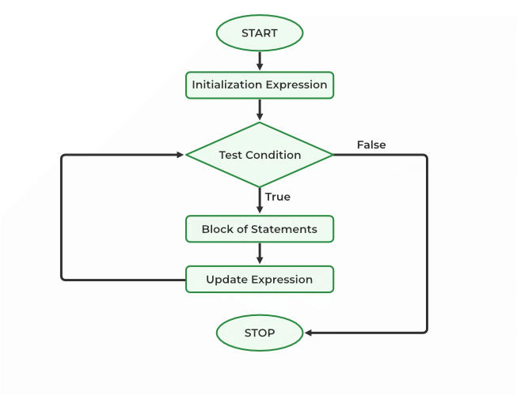
Flow chart of For Loop

Slide 8
Example of For Loops
#include <iostream>
using namespace std;
int main()
{
for (int i = 0; i < 5; i++)
{ cout << i << "\n"; }
}

Slide 9
While Loop
The “while loop” is a conditional structure that is used to execute a statement or set of statements as long as the given condition remains true.
This loop structure is used when the programmer does not know in advance.
Syntax of while Loop:
while (condition)
{ // code block to be executed }

Slide 10
Execution of For Loop
When a “while loop” statement is executed the condition is evaluated first. If the condition is true then body of loop is executed.
After executing the body of loop, the execution control goes back to the “while” statement and evaluates the condition again. If the condition is still true then body of loop is executed
The process is repeated. When the condition becomes false at any stage during execution, the loop is terminated.

Slide 11
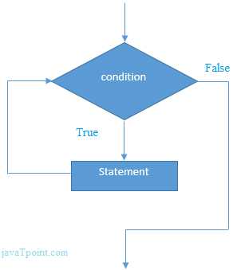
Flow chart of While Loop

Slide 12
Example of For Loops
#include <iostream>
using namespace std;
int main()
{
int i = 0; while (i < 5)
{ cout << i << "\n"; i++; }
}

Slide 13
Do-While Loop
As a “while loop”, do while loop is also used to execute a statement or set of statements as long as the given condition remains true.
The condition comes after the body of loop
The condition is evaluated after executing the body of loop
The bod of loop executed at least once even if the condition is false.
Semicolon (;) is given after the while (condition)
Syntax of while Loop:
do { // code block to be executed } while (condition);

Slide 14
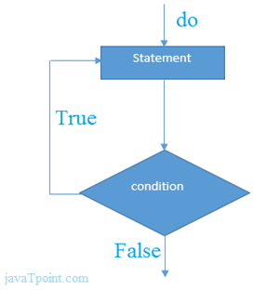
Flow chart of Do-While Loop

Slide 15
Example of For Loops
#include <iostream>
using namespace std;
int main()
{
int i = 0; do
{ cout << i << "\n"; i++; } while (i < 5);
}

